Slide 1
Towards the evolution characteristics of product structural properties based on the time-dependent network
Journal of Engineering Design (2022)
Yu Peng Li, Yongbo Ni, Na Zhang, Qinming Liu & Jin Cao
2022.03.27
유재상

Slide 2
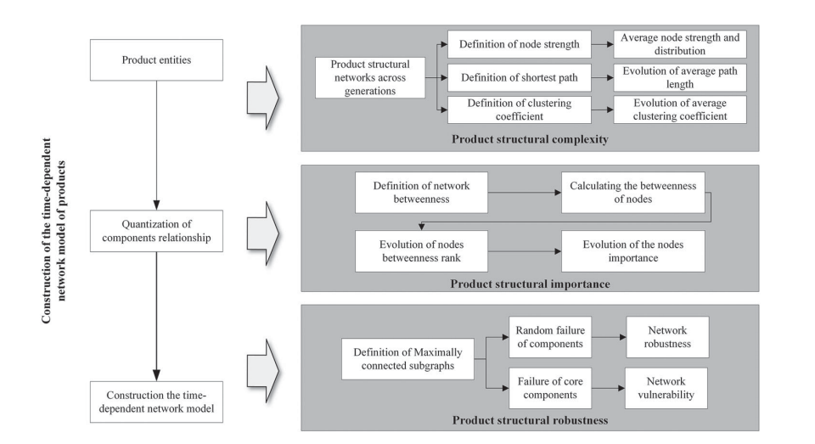
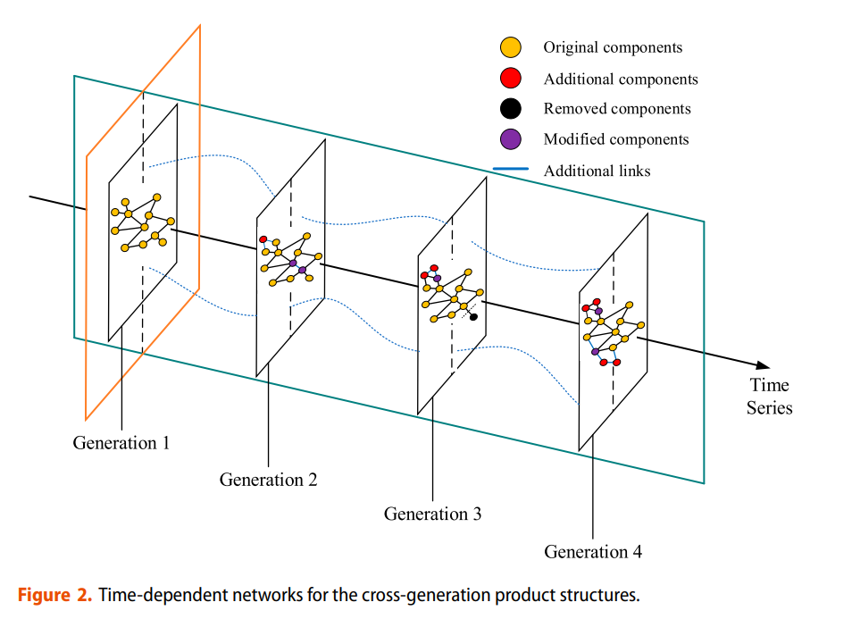
Background) time-dependent network and product structure properties
How to analyze product structure properties ?
Evolution characteristics of product structural properties
Similar with organisms (진화론)
- Adapt dynamic environment (customer requirements, updating key technologies, changing markets and policies)
- Require evolving continuously
Not just focus on certain product generation (ex. Commonality) ➔ Cross-generation product evolution process
- Exist some trends (patterns) while changing product structure properties
Suggestions and directions for optimizing product structure and designing evolution-adapted products

Slide 3
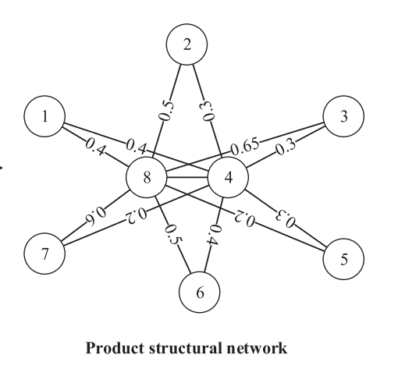
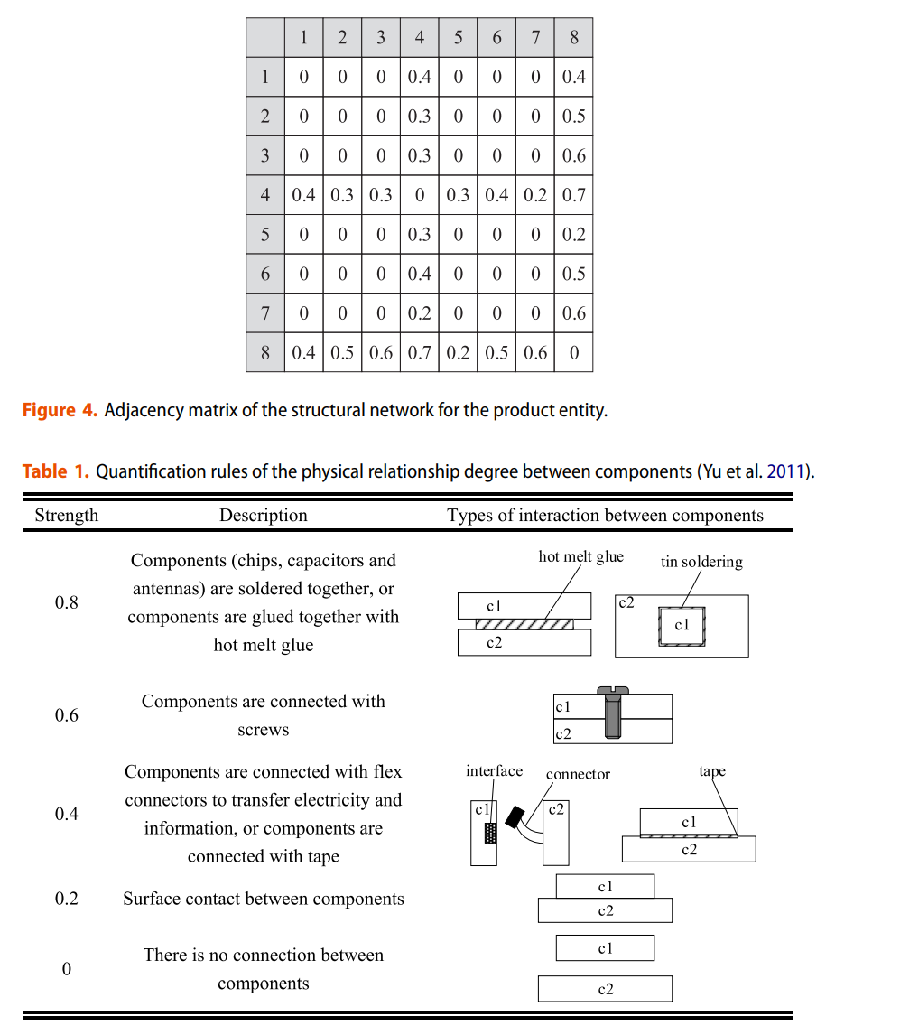
Construction the time dependent network model
Build the T-generation network model
Only consider physical relationship degree between two components (limitation)
Product structural network
Filling whole components relationship
Quantization of components relationship
Important factors
description
Reason
- Enhance productivity
- Reduce cost
- Find a pivotal role component
(favorable information)
- Examine structural Inherent tolerance against failures design changes of a product
Structural complexity
Structural importance
Structural robustness
Structural relationship
Structural influence
Structural stability

Slide 4
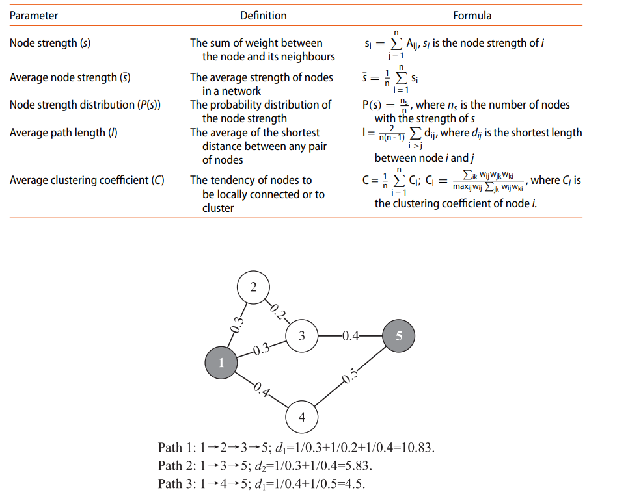
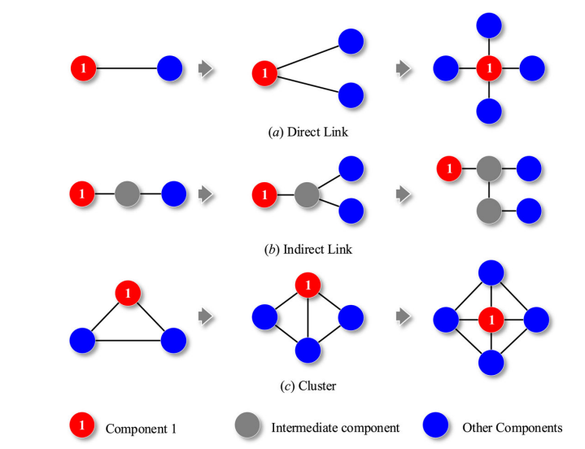
i) Product structure complexity (Average node strength, average path length, clustering coefficient)
Average node strength : 얼마나 각 component가 다른 components 들과 연결되어있는가
Average Path length : node에서 node 간의 평균 최단 거리
Average clustering coefficient : 얼마나 각 nodes 들이 locally connected 되었는가
Node Strength(S_{i})
Path length (d_{ij})
Clustering coefficient (C_{i})
S_{i} = 0.2 + 0.3 + 0.4 = 0.9
d_{ij} = path 3 = 4.5

Slide 5


ii) Product structural importance & iii) Product structural robustness
Case 1)
Case 2)
If 2 failure occurs
MCR = 5/5 = 1
MCR = 3/5 = 0.6
ii) Product structural importance (Betweenness centrality)
Betweenness reflects the role of a node as a bridge in the entire network.
If many shortest paths go through the node ➔ important influence on the network.
iii) Product structural robustness (Maximum connected ratio with RFC, FCC)
RFC : Random failure of components
FCC : Failure of core components
➔ Because of scale-free characteristics
Robust in RFC
Vulnerable in the FCC
➔

Slide 6
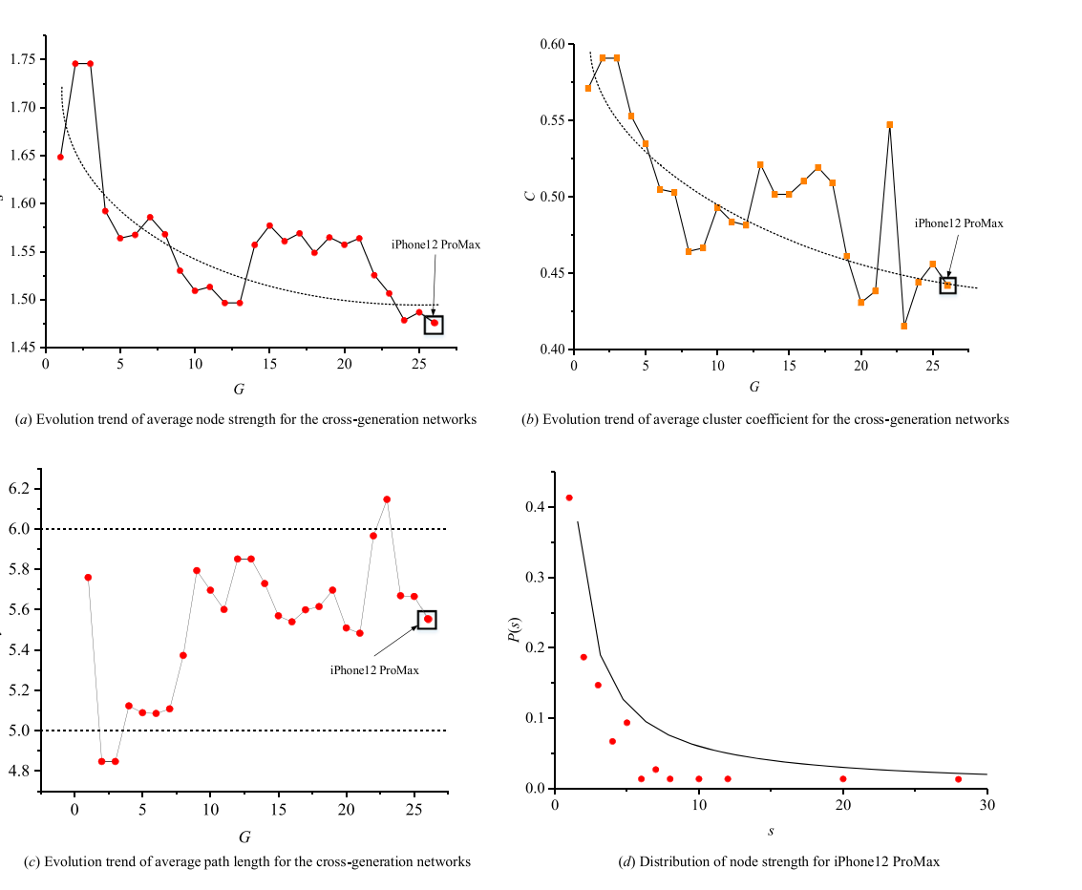
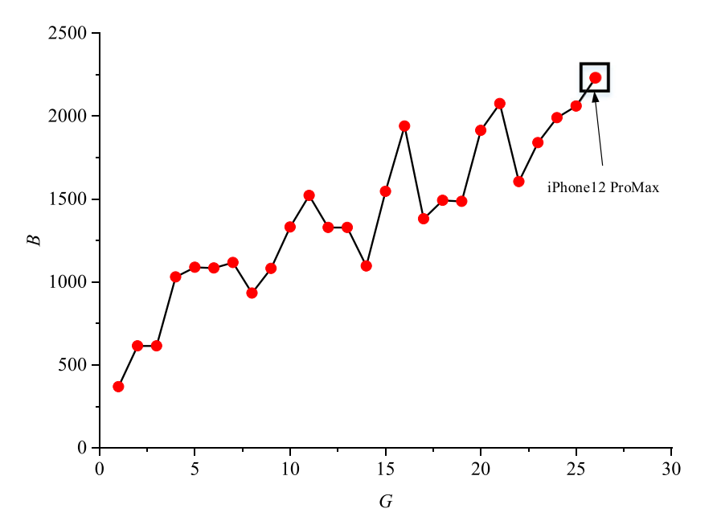
Case study with 25 generations of i-phones and conclusion
Conclusion (Contribution)
Organism (진화론)이라는 다른 분야의 idea를 product design에 접목하고자 함
단순 specific period 에서의 분석이 아닌, trend를 통해 향후 제품 디자인의 방향성을 제시함
기존 여러 논문에서의 index값들을 활용하여 전체적으로 product structural properties를 파악하고자 함
Limitation
Network에서의 각 component 의 관계를 단순히, physical relation으로만 봄
Generation이 많아야 분석이 용이
Time-dependent network를 활용한다고 하였지만, 각 세대 간의 연결성이 부족 (단순 각 세대의 structure properties 값을 plotting 함)
각 Structural properties를 바탕으로 종합적인 판단이 부족 (여러 지표들로 부터 종합적으로 어떤 component 를 바꿔야 하는지 등등)

